Slide 1
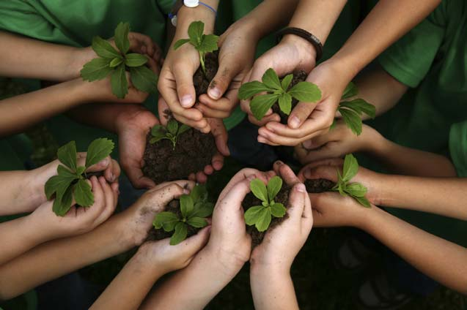
Nevada School Garden Conference
Ashley Jeppson &
Adriana Marín
NDA Agriculturists
April 14, 2018

Slide 2
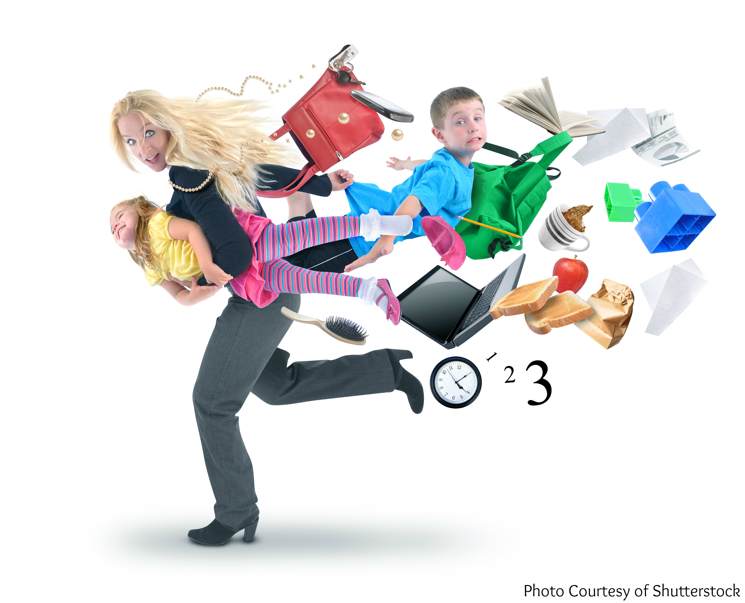
First of all: Thank YOU!
For your role as:
Teachers
Parents
Volunteers
Champions
Role Models
Leaders

Slide 3
Thank you, supporters!
Farmers
Non-profits
Government agencies
Sponsors
Mountain View Montessori!!!

Slide 4
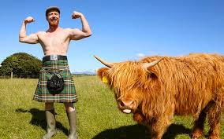
Your role is important to the FUTURE!
As our farmers age, we will need new inquisitive, healthy, strong and ingenious farmers!
In 1987, more than 21% of all farmers were 65 and over (Gale, 1993)
In 2012, that percentage went up to 33% (USDA Census 2014)

Slide 5
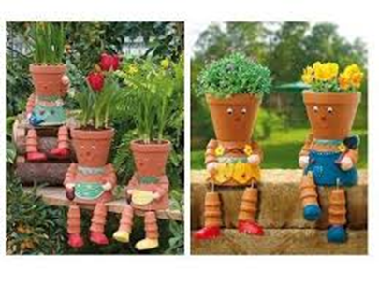
You are raising the growers of today and of tomorrow
Children have a significant impact on their parents’ habits and students constantly transfer knowledge from school to home on themes such as:
Recycling
Stewardship of plants and animals
and the biology of their habitats
Respectful interracial peer relationships
Languages, geography and cultures around the world
AGRICULTURE at home will have a long-lasting impact in many ways!

Slide 6
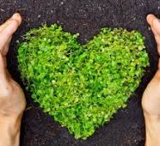
Academic Achievement
Inquiry
Connection to natural world
Formulation of meaningful questions
Pleasure in learning
Positive attitudes
Score significantly higher on science achievement tests (www.dug.org)

Slide 7
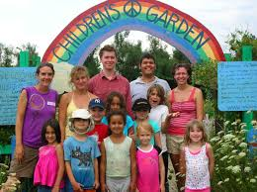
Science vs. Real Life
“While students begin elementary school exhibiting spontaneous interest in science and math, they often emerge fearing mathematics and disdaining science as too dull and too hard to learn…Research indicates that many teachers, as well as students, believe science to be a set of facts and rules with ‘right’ answers, rather than a process of discovery with many possible outcomes.” (Klemmer et al. 2005)
“Students, in particular, do not see science as connected with society or offering ways to improve peoples’ lives, and many regard it as disconnected and removed from their own daily lives” (Klemmer et al. 2005).

Slide 8
Physical Health
School gardening:
Influences to eat more fruits and vegetables.
Exposes to healthy food.
Exposes to moderate exercise involved in planting, watering, weeding, fertilizing, mulching and harvesting.
Can lead to lifetime of gardening. (www.dug.org)
Can incorporate other cultural food knowledge: i.e., Native American “three sisters” garden: corn, beans and squash.
Can increase school salad bar use (GEM No. 412, Oklahoma State University).

Slide 9
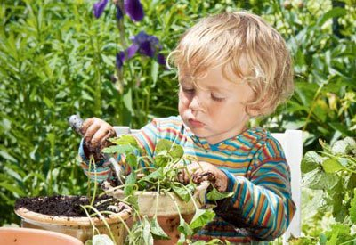
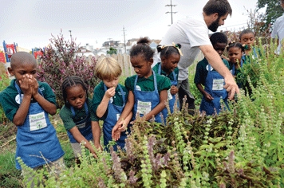
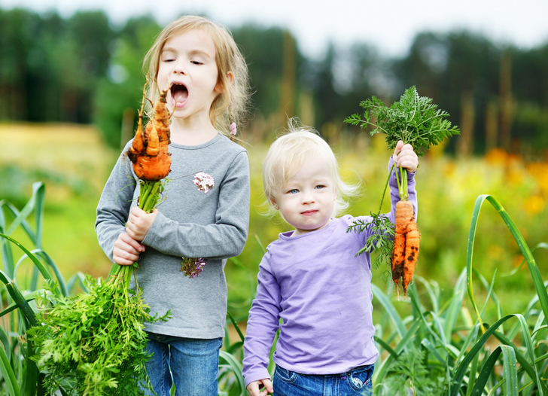
Social and Emotional Health
Tend to feel calm, safe, happy and relaxed.
More likely to accept people different from themselves.
Increases self-understanding, interpersonal skills, and cooperative skills (www.dug.org).
Feeling of ownership.
Constructivist learning theory: hands-on and concrete experiences.

Slide 10
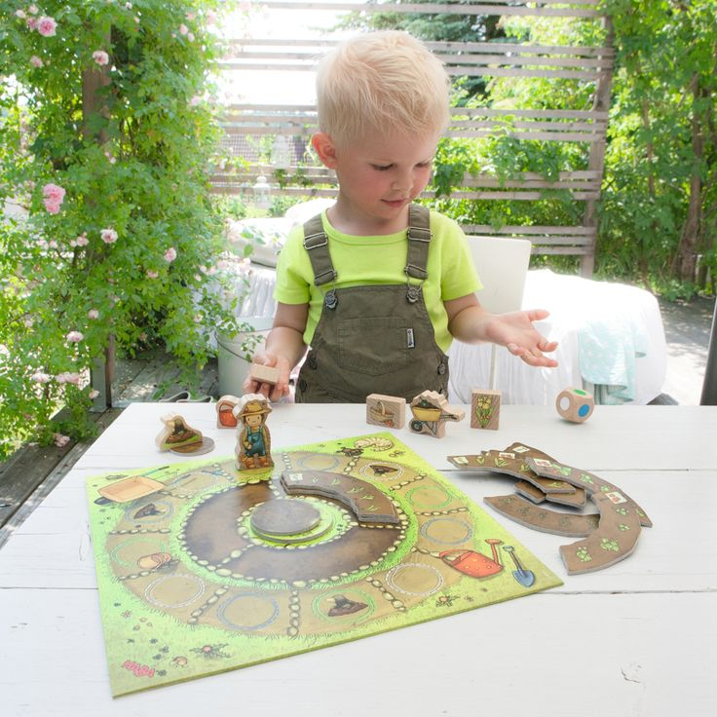
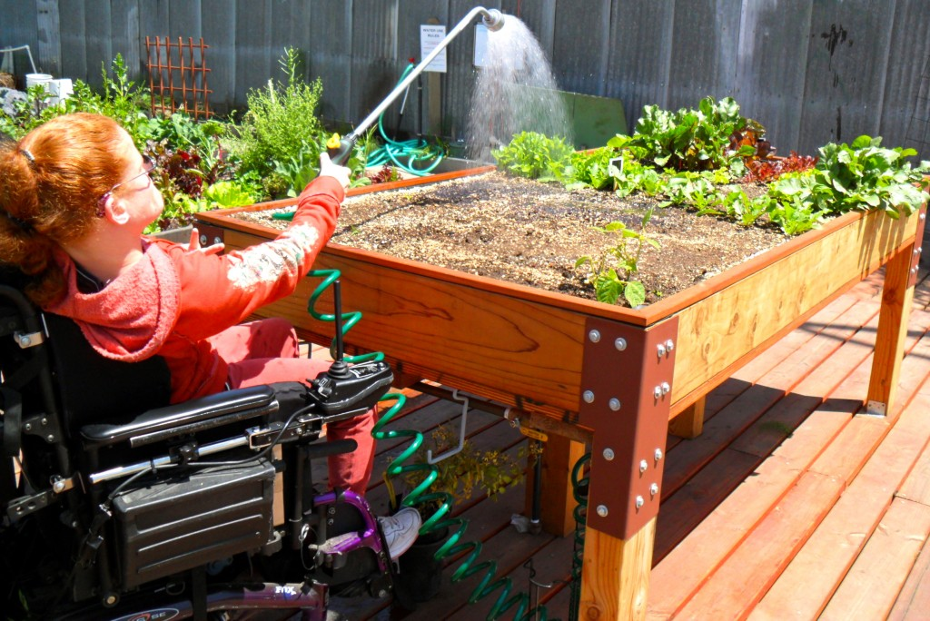
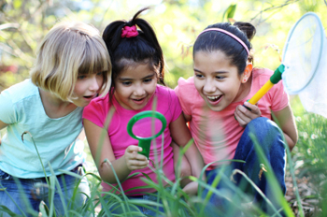
Social and Emotional Health
Decision making and problem-solving skills
Nature on a personal level: responsibility, empathy
Increased learning and comprehension in underachieving elementary students
Disabled children reported feeling successful in proportion to the success of others (DeMarco, Relf, and McDaniel 1999)

Slide 11
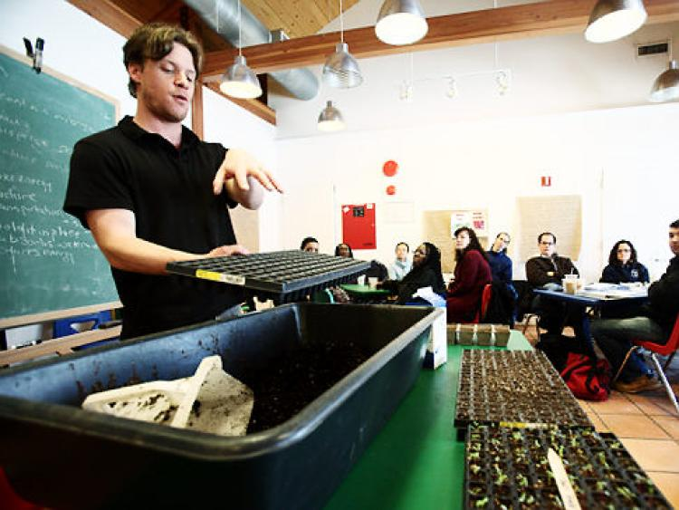
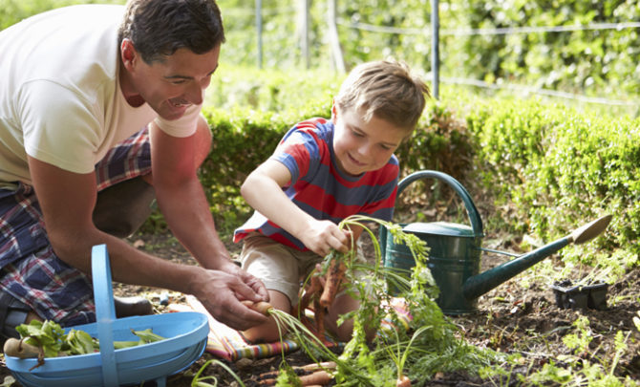
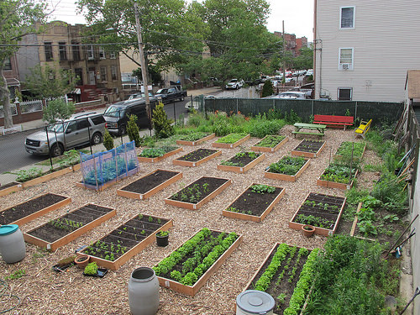
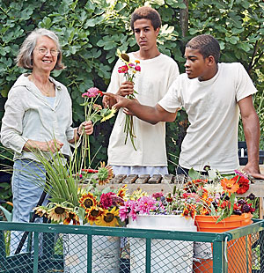
School and Community Benefits
Teachers have higher workplace morale and increased satisfaction.
Students share what they learn with family and friends.
Community gardens can increase home prices for residences near the garden.
Community gardens can lead to reduction in violent and non-violent crime in the neighborhood.
Increased feeling of safety.
www.dug.org

Slide 12
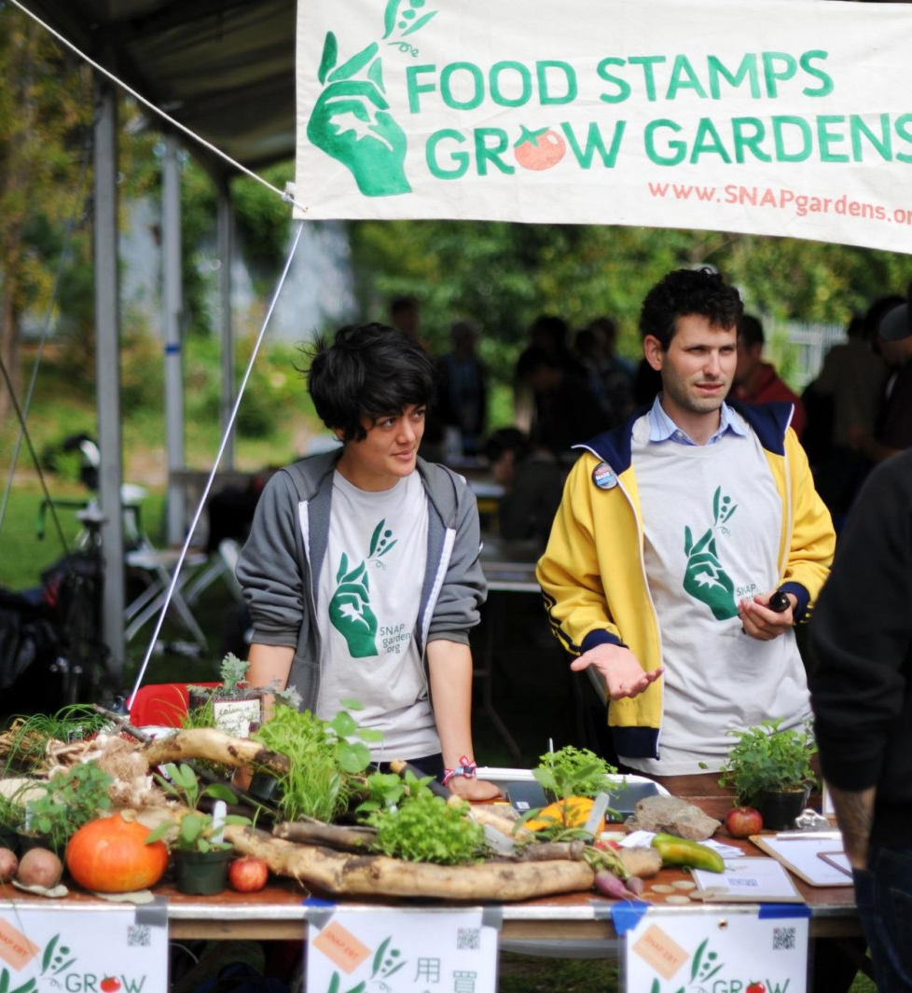
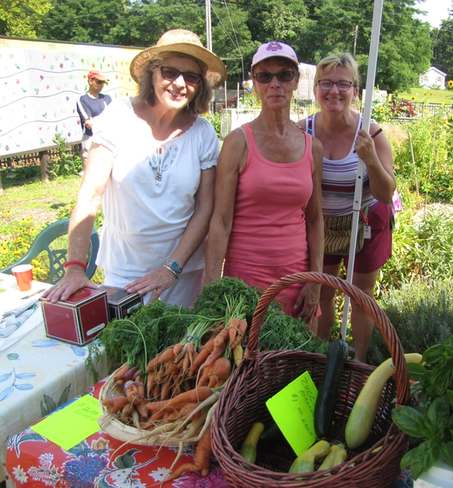
More school and community benefits!
In Denver study:
95% of community gardeners give away some produce they grow to people in need, family or friends.
60% specifically donate to food assistance programs.
80% of gardeners started gardening as children.
More than 50% of these gardeners meet national guidelines for fruit and vegetable intake compared to 25% of non-gardeners (www.dug.org).
Teachers can use greenhouse to grow plants/flowers to generate school revenue (GEM No. 412)

Slide 13
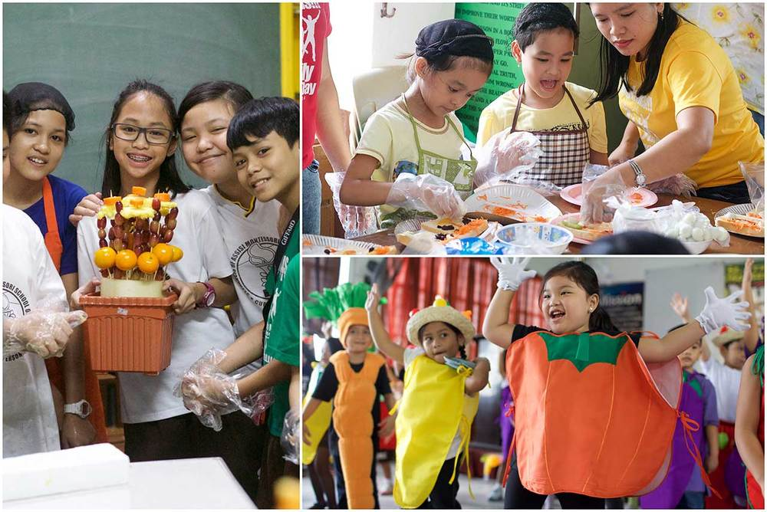
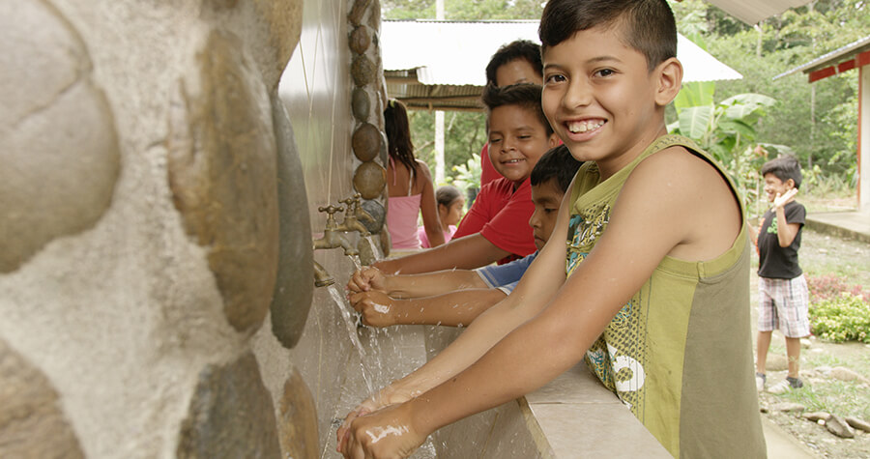
Relationship with NDA
Curriculum integration
Food safety skills
(labels/hand washing)
Connecting growers to
school programs
Funding opportunities:
SB 167 & SCBGP
Information sharing
Farm to school
webpage resources

Slide 14
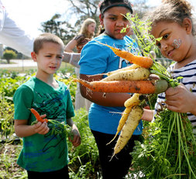
Our Role-producer certificate
NDA is in the process of visiting farms and establishing educational and professional relationships with the growers.
Transferring the grower permits to our online system.
Same date of expiration for all: 3/31/2019
We are learning from you too and want to be involved to help!

Slide 15
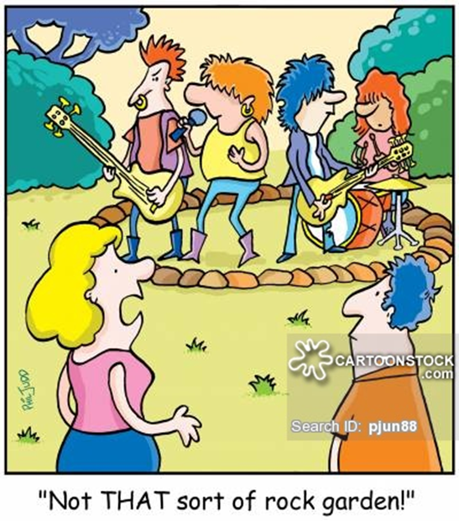
Keep it growing!
Our future jobs depend on your influence on these little farmers!
“Exposing young children to gardening at school is an avenue for cultivating future generations of gardeners, as well as future generations of professional horticulturists.” (DeMarco et al. 1999).
“A critical precursor to producing science literate adults is actively involving kids in experiential science activities when they are young” (Loucks-Horsley et al.1990).

